Slide 1

Oracle 12c: SQL
Chapter 1
Overview of Database Concepts
©2016. Cengage Learning. All rights reserved.

Slide 2
Objectives
Explain database design using entity-relationship models and normalization
Explain the purpose of a Structured Query Language (SQL)
Understand how this textbook’s topics are sequenced and how the two sample databases are used
©2016. Cengage Learning. All rights reserved.

Slide 3
Database Design
Systems Development Life Cycle (SDLC)
Entity-relationship model (E-R model)
Normalization
©2016. Cengage Learning. All rights reserved.

Slide 4
Systems Development Life Cycle (SDLC)
Systems investigation – understanding the problem
Systems analysis – understanding the solution
Systems design – creating the logical and physical components
Systems implementation –creating the system
Systems integration/testing – testing system
Systems deployment – placing completed system into production
Systems maintenance and review – evaluating the implemented system
©2016. Cengage Learning. All rights reserved.

Slide 5
Entity-Relationship Model
(E-R Model)
Used to depict the relationship that exists among entities
The following relationships can be included in an E-R model:
  One-to-one
  One-to-many
  Many-to-many

Slide 6
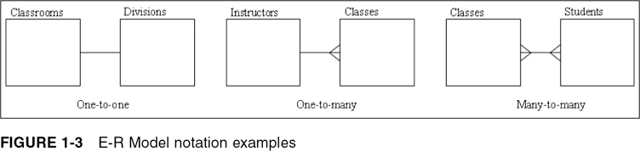
E-R Model Notation Examples
©2016. Cengage Learning. All rights reserved.

Slide 7
Database Normalization
Implementing a design that eliminates redundancies
Determines required tables and columns(fields) for each table
Multistep process
Used to reduce or control data redundancy

Slide 8
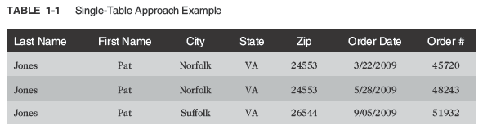
Database Normalization (continued)
Data redundancy – refers to having the same data in different places within a database
Data anomalies – refers to data inconsistencies

Slide 9
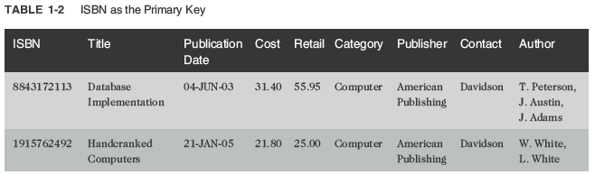
Unnormalized Data
Contains repeating groups in the Author column in the BOOKS table

Slide 10
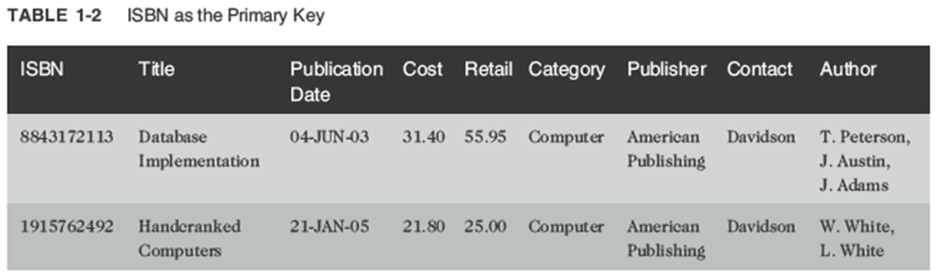
First-Normal Form (1NF)
When all values of the column are atomic (contain no repeating values
1st step --Identify a primary key
Primary key is a field that identifies each record uniquely
Repeating groups are eliminated

Slide 11
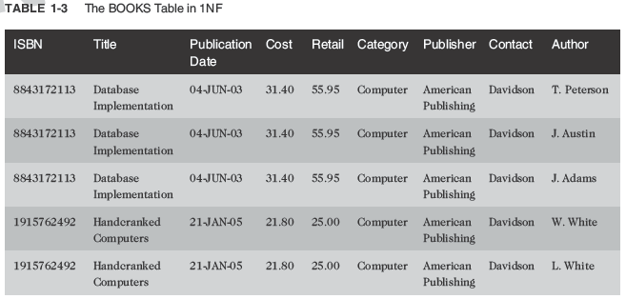
First-Normal Form (1NF) (continued)
ISBN and Author columns together create a composite primary key

Slide 12
Composite Primary Key
Composite Primary key is where more than one column is required to uniquely identify a row
Can lead to partial dependency – a column is only dependent on a portion of the primary key
For instance, a book’s title, publication date, and publisher name, depend on the book itself---not the authors.

Slide 13
Second-Normal Form (2NF)
Partial dependency must be eliminated
  Break the composite primary key into two parts, each part representing a separate table
By breaking this table into two separate tables, books and authors, we remove the partial dependency.
By removing the partial dependency, we have now converted our tables to Second-Normal Form.

Slide 14
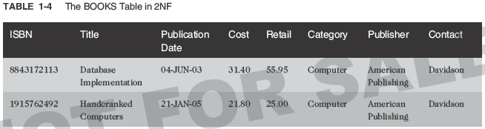
Second-Normal Form (2NF) (continued)
BOOKS table in 2NF

Slide 15
Second-Normal Form (2NF)
Now we look for any transitive dependencies.
Transitive dependencies means that at least one value in the record isn’t dependent upon the primary key, but on another value in the record.

Slide 16
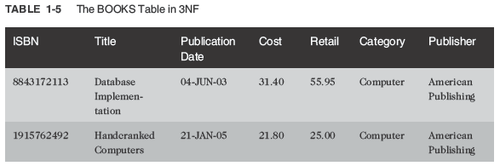
Third-Normal Form (3NF)
Publisher contact name has been removed
Because the table was in 2NF and had all the transitive dependencies removed, this table is now in third-normal form (3NF)
©2016. Cengage Learning. All rights reserved.

Slide 17
Summary of Normalization Steps
1NF: eliminate repeating groups, identify the primary key
2NF: table is in 1NF, and partial dependencies are eliminated
3NF: table is in 2NF, and transitive dependencies are eliminated
Note: there are several levels of normalization beyond 3NF, but in practice most tables are normalized to only 3NF
©2016. Cengage Learning. All rights reserved.

Slide 18
Relating Tables within the Database
Once tables are normalized, make certain tables are linked
Tables are linked through a common field- a field that exists in both tables
A common field is usually a primary key in one table and a foreign key in the other table
A foreign key appears on the “many” side, on a one to many relationship, and isn’t necessariy the primary key in that table.
©2016. Cengage Learning. All rights reserved.

Slide 19
Relating Tables within the Database
Important to note. Many to many relationship cannot exist in a relational database.
The most common way to get rid of a “many-to- many” relationship is to create two “one-to-many” relationship and add a bridging entity
A bridging entity is placed between the original entities and serves as a filter for the data.
©2016. Cengage Learning. All rights reserved.

Slide 20
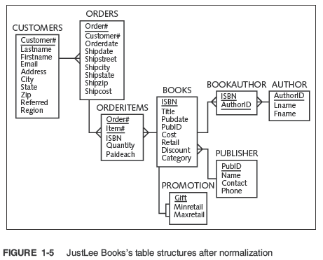
©2016. Cengage Learning. All rights reserved.

Slide 21
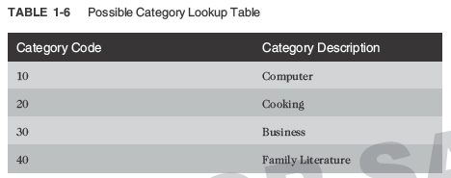
Lookup Table
Common reference for descriptive data tables referenced in a foreign key
©2016. Cengage Learning. All rights reserved.

Slide 22
Structured Query Language (SQL)
Officially “S-Q-L, many still say “sequel”
Data sublanguage
Used to:
  Create or modify tables
  Add data to tables
  Edit data in tables
  Retrieve data from tables
ANSI (American National Standards Institute) and ISO(International Organization for Standardization) standards
©2016. Cengage Learning. All rights reserved.

Slide 23
Databases Used in this Textbook – JustLee Books Database
Assumptions
  No back orders or partial shipments
  Only U.S. addresses
  Completed orders are transferred to the annual SALES table at the end of each month to enable faster processing on the ORDERS table
©2016. Cengage Learning. All rights reserved.

Slide 24
Topic Sequence
The first half of the text will focus on creating a database
The second half of the text will focus on querying or retrieving data from a database
©2016. Cengage Learning. All rights reserved.

Slide 25
Summary
A record is in first-normal form (1NF) if no repeating groups exist and it has a primary key
Second-normal form (2NF) is achieved if the record is in 1NF and has no partial dependencies
After a record is in 2NF and all transitive dependencies have been removed, then it is in third-normal form (3NF), which is generally sufficient for most databases
A primary key is used to uniquely identify each record
©2016. Cengage Learning. All rights reserved.

Slide 26
Summary (continued)
A common field is used to join data contained in different tables
A foreign key is a common field that exists between two tables but is also a primary key in one of the tables
A lookup table is a common term for a table referenced in a foreign key
A Structured Query Language (SQL) is a data sublanguage that navigates the data stored within a database’s tables
©2016. Cengage Learning. All rights reserved.

